Slide 1

ENHANCING SALES STRATEGY OF E-LEARNING PLATFORMS USING MACHINE LEARNING

Slide 2

OBJECTIVE
The purpose of this project is to study how machine learning can be used for optimizing sales. Historical behavioural data is used as training data for the classification algorithm. The results suggest that it is possible to estimate the purchase probability of leads using supervised learning algorithms, such as random forest, logistic regression and one can obtain new business insights from the results using visual analytics relevant for decision-makers. The calculated purchase probability can then be used by companies to solve different business problems, such as optimizing their sales processes.

Slide 3
INTRODUCTION
One of the most critical business decisions of a company is related to customer acquisition. During the acquisition phase of the customer life cycle, companies try to convert leads into customers through different methods. One useful way to save time while increasing sales is to make sure that we focus on the best available leads and not waste time on inactive leads. There are various methods applied by organizations in prioritizing which customer leads to target. In the typical case, the evaluation is based on activities performed by the potential customer when interacting with the company through different channels. This may include several features like time spent on website, total visits, occupation etc.

Slide 4
PREDICTIVE SCORING
Business to customer marketing.
Ranking leads based on their activities( like the levels of awareness, interest, and readiness to make a purchase decision).
Prioritizing customers.
BENEFITS-
Increased sales.
Spending more time on leads that are more likely to convert. Hence increased morale for the sales team.
As more data is accumulated in the system, prediction quality will increase.

Slide 5
WHY E-LEARNING PLATFORMS ?
E-learning is getting more and more popular. In fact, it is working side by side with many conventional methods of education.
Companies as well as developers of e-learning platforms are convinced that it is very convenient and flexible option which promotes active and independent learning.
In this type of learning, user has freedom to various resources in several varying formats.

Slide 6
DATA DESCRIPTION
Our dataset contains two classes:
1. Implicit data obtained from actions of leads on website
2. Explicit data obtained directly from customer’s own input
Dataset contains-
9000 data points
37 attributes such as Lead source, Total Time spent on website, Total visits, Last activity, Specialization, Lead origin etc.
The target variable, ‘Converted’ which tells whether lead was converted or not wherein 1 means it was converted and 0 means it wasn’t converted.

Slide 7
DATA INSPECTION AND CLEANING
Since there are many variables that have a level ‘Select’ so we convert it into null values.
We dropped the columns having more than 70 percent null values. We took care of all null values in each column one by one by using NumPy, pandas, and matplot libraries.
Filling the null column values with the mean or dominant values and dropping rows with less than 2 percent of null values.
Categorical variables were encoded and feature scaling was done for variables having great variation in their data.

Slide 8
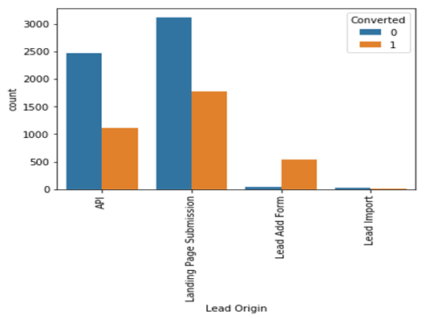
DATA VISUALISATION AND DATA ANALYSIS
We analysed important attributes of our data which have a large effect on conversion rates.
1. Lead Origin- Inference achieved by lead origin is to improve overall lead conversion rate, we need to focus more on improving lead conversion of API and Landing Page Submission origin and generate more leads from Lead Add Form.

Slide 9
DATA VISUALISATION AND DATA ANALYSIS
We calculated the percentage conversion rate for each lead origin-
1. API and Landing Page Submission have 30-35% conversion rate but count of lead originated from them are considerable.
2. Lead Add Form has more than 90% conversion rate but count of lead are not very high.

Slide 10
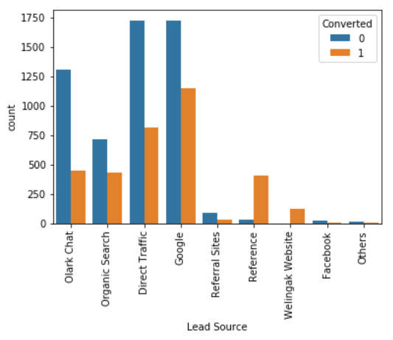
DATA VISUALISATION AND DATA ANALYSIS
2. Lead Source-
1. Google and Direct traffic generates maximum number of leads.
2. Conversion Rate of reference leads and leads through welingak website is high.
INFERENCE FROM LEAD SOURCE DATA-
To improve overall lead conversion rate, focus should be on improving lead conversion of direct traffic and google leads and generate more leads from reference and welingak website.

Slide 11
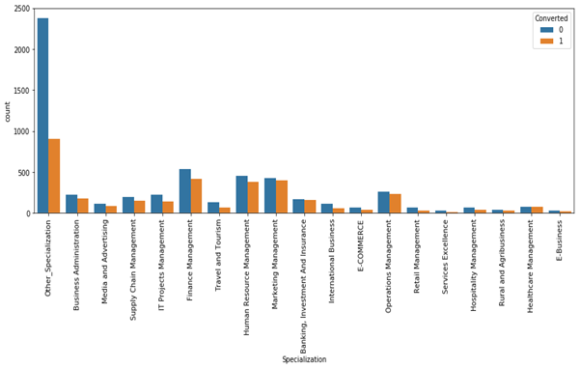
DATA VISUALISATION AND DATA ANALYSIS
3. Specialization-
HR management, Marketing Management Specialization has more leads as well good conversion rate than other specialization.
Business administration, Operations Management, Banking Investments and Insurances Specialization have less number of users but conversion rate is good.
INFERENCE FROM SPECIALIZATION DATA-
To improve overall lead conversion rate, more new courses on finance, HR management and marketing can be added.

Slide 12
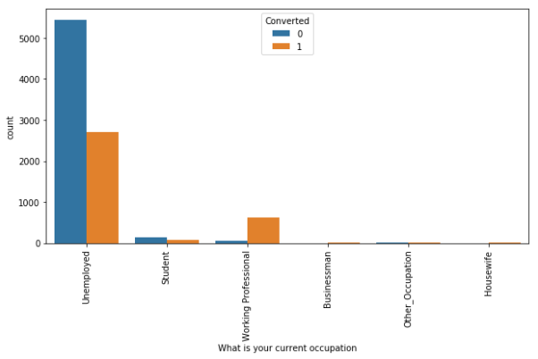
DATA VISUALISATION AND DATA ANALYSIS
4. OCCUPATION-The two main segments of customers to focus on are –
Unemployed & Working professionals.
INFERENCE FROM OCCUPATION DATA-
1.Most of the users are unemployed and their conversion rate is also less.
2.Working Professional has a very good conversion rate but the users are very less.
3.Student has fairly good conversion rate but the users are very less.

Slide 13
FEATURE EXTRACTION
Feature extraction involves reducing the number of resources required to describe a large set of data. When performing analysis of complex data one of the major problems stems from the number of variables involved.
Analysis with a large number of variables generally requires a large amount of memory and computation power.
Feature extraction plays a major role in increasing the accuracy of the machine learning model

Slide 14
TECHNIQUE WE USED FOR FEATURE ELIMINATION-
RECURSIVE FEATURE ELIMINATION(RFE)-
RFE is a feature selection method that fits a model and removes the weakest feature (or features) until the specified number of features is reached.
RFE attempts to eliminate dependencies and collinearity that may exist in the model.
RFE requires a specified number of features to keep, however it is often not known in advance how many features are valid. To find the optimal number of features cross-validation is used.

Slide 15
MACHINE LEARNING MODELS
The following machine learning algorithms were used for training and testing various models-
1. Logistic Regression
2. K Nearest Neighbour
3. Support Vector Machine
4. Naive Bayes
5. Random Forest Classification

Slide 16
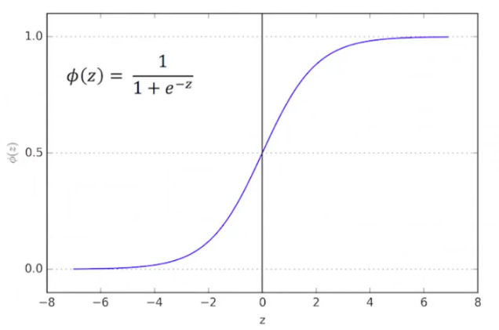
MODEL ARCHITECTURE
1. Logistic Regression-
Logistic regression is a predictive analysis regression technique where the dependent variable is categorical. It is used to describe data and to explain the relationship between one dependent binary variable and one or more independent variables. It uses a logistic function called sigmoid function as its activation function which outputs the value between 0 and 1 and is defined as –

Slide 17

MODEL ARCHITECTURE
Where z is the hypothesis function for the classification problem defined as Z = b₀ + b₁x₁ + b₂x₂ + b₃x₃ + …
Where ϕ is the predicted output, b₀ is the bias or intercept term and b₁ is the coefficient for the single input value (x).
The cost function which used is

Slide 18
MODEL ARCHITECTURE
Following the results of the first models many models very made each having different sets of hyper parameters for getting the improved results. Following are the hyper parameter tuning which were done-
1. Optimizer
2. Regularization
3. Number of iterations

Slide 19
RESULTS FROM LOGISTIC REGRESSION
S.NO. | Accuracy achieved | Hyperparameters used
1. | 91.36% | LBFGS optimizer, L2 regularization, 200 Iterations
2. | 90.87% | LBFGS optimizer, L2 regularization, 100 Iterations
3. | 89.06% | Newton-CG optimizer, L2 regularization, 200 Iterations

Slide 20
MODEL ARCHITECTURE
2. K Nearest Neighbor –
The principle behind nearest neighbor method is to find a predefined number of training samples closest in distance to the new point, and predict the label from these. The number of samples can be a user-defined constant or vary based on the local density of points.
Steps for using the K Nearest Neighbor algorithm-
Select the number K of neighbor.
Algorithm takes the KNNs of the new data point according to the type of distance specified.
Among the K neighbors, it counts the number of data points in each category.
The new data points is then assigned to the category the most counted neighbors are.

Slide 21
MODEL ARCHITECTURE
Different models were made by using different types of hyper parameters which are as follows-
1. Number of neighbors
2. Weights
Uniform - All points in each neighborhood are weighted equally
Distance - weight points by the inverse of their distance.
3. Metrics (The type of distance to take).

Slide 22
RESULTS FROM KNN
S.NO. | Accuracy achieved | Hyperparameters used
1. | 91.06% | Minkowski metrics, 5 neighbors , uniform weights
2. | 90.87% | Minkowski metrics, 6 neighbors , uniform weights
3. | 86.26% | Euclidean metrics, 7 neighbors, distance weights

Slide 23
MODEL ARCHITECTURE
3. Support Vector Machine(SVM)-
In the SVM algorithm, we plot each data item as a point in n-dimensional space (where n is number of features specified) with the value of each feature being the value of a particular coordinate. Then, the algorithm performs classification by finding the hyperplane that differentiates the two classes very well.
Some of the hyper parameters of the model include –
1. Kernel
2. Gamma
3. C - Penalty parameter

Slide 24
RESULTS FROM SVM
S.NO. | Accuracy achieved | Hyperparameters used
1. | 91.37% | Linear kernel, Scale gamma, C = 1
2. | 91.93% | RBF kernel, Scale gamma, C = 1
3. | 91.75% | Linear kernel, Scale gamma, C = 15

Slide 25
MODEL ARCHITECTURE
4. Random Forest Classification-
It is an ensemble tree-based learning algorithm for classification problems. It is a set of decision trees from randomly selected subset of training set. The algorithm creates decision trees on data samples and then gets the prediction from each of them and finally selects the best solution by means of voting. It aggregates the votes from different decision trees to decide the final class of the test object. It is an ensemble method which is better than a single decision tree because it reduces the over-fitting by averaging the result.

Slide 26
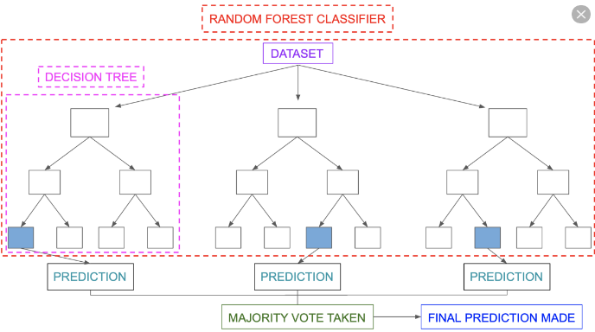
MODEL ARCHITECTURE
Steps for using the random forest algorithm –
1. Random k data points are picked from the training set.
2. Decision tree associated with the k data points is made
3. Number of trees are selected and steps 1st and 2nd are repeated
4. The algorithm for new data point makes each of the N decision trees to predict the output value of the new data point and the new data point is then averaged across all the predicted values.

Slide 27
MODEL ARCHITECTURE
The hyper parameters which were tuned in the process were-
1. Number of estimators
2. Criterion of split
Gini
Entropy
3. Maximum number of features
None – Sets the max_features as n_features
Auto – Sets the max_features as sqrt(n_features)
Log2 – Sets the max_features as log₂(n_features)

Slide 28
RESULTS FROM RANDOM FOREST
S.NO. | Accuracy achieved | Hyperparameters used
1. | 91.11% | Entropy estimator, Auto attribute for max no. of features , 150 number of estimators ,
2. | 90.97% | Entropy estimator, None attribute for max no. of features , 150 number of estimators ,
3. | 90.67% | Entropy estimator, Auto attribute for max no. of features , 100 number of estimators ,

Slide 29
ACCURACY OF TESTED MODELS
S.NO. | MODEL ARCHITECTURE | HIGHEST ACCURACY ACHIEVED
1. | LOGISTIC REGRESSION | 91.36%
2. | K NEAREST NEIGHBOUR | 91.06%
3. | SUPPORT VECTOR MACHINE | 92.37%
4. | NAÏVE BAYES | 87.54%
5. | RANDOM FOREST CLASSIFICATION | 91.11%

Slide 30
CONCLUSION
Sales is an important process of a company as it directly affect revenue of a company. So, we present various models that takes an input from customers and prioritize them according to their interests so that sales team will focus on potential leads which will help in increasing the overall efficiency of the company. By using 5 classification models and tuning a huge amount of hyperparameters we obtained an accuracy of 92.37 percent and ranked them according to their predictive score. The analysis also showed how feature extraction and selection plays a crucial role in the accuracy of the models.

Slide 31
THANK YOU

